Slide 1
Global Disease Outbreak Analysis
Analyzed WHO data using Excel Pivot Tables, Charts & Trendlines

Slide 2
Introduction
This presentation will provide an in-depth analysis of the medical data, showcasing key findings, insights, and visual representations.

Slide 3
01
Analysis Overview
Analyze WHO’s historical disease outbreak data (1996–2022)
Identify global, regional, and country-level trends
Showcase impact of pandemics (H1N1, COVID-19)
Demonstrate Excel-based data analysis skills

Slide 4
Year Wise Trend
Spikes in 2009 (H1N1) and 2020–2022 (COVID-19)
Overall increasing trend in outbreaks over 27 years

Slide 5
Continent-Wise Analysis
Africa had the highest overall outbreaks (~37%)
Asia and Americas showed strong upward trends
COVID-19 caused synchronized spikes worldwide

Slide 6

Country-Level Trends
DRC has the highest level of disease outbreak followed by Liberia and Cambodia.
Surprisingly big countries like USA, India, China are not in the top of the list

Slide 7
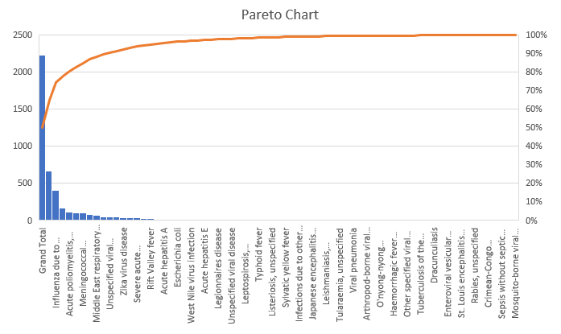
Disease wise Analysis

Slide 8

Conclusions
Global outbreaks are rising — data-driven policy is key
Project helped me improve:
Trend detection
Data storytelling
Excel dashboarding

Slide 9
Thank you!
Do you have any questions?

